Slide 1
Linux final presentation
Brianna clarke

Slide 2
introduction
Linex is one of the most popular operating systems in the industry.
Linnux is widely used on IoT projects.

Slide 3
Linux file system hierarchy
Navigated the Linux file system tree.
Created directories and files.
Copied and removed directories and files.
Located directories and files.

Slide 4
Navigate the Linux filesystem tree
1. What is the pwd command an acronym for? What about the cd command?
Answer here:
pwd – print working directory – shows the path for the current directory.
cd – change directory – change over to the directory that you specify.
2. Explain the differences between a relative path and an absolute/full path in Linux.
Answer here:
Relative path: path based on your current location.
Absolute path: path starting at the very top of the filesystem, which is the root - /.

Slide 5
Create directories and files

Slide 6
Copy and remove directories and files

Slide 7
Locate directories and files

Slide 8
Linux shell scripts
We created a shell script
Chage script file permissions.
Set PATH variable.
Made the PATH variable permamnent.

Slide 9
Create a shell script
1. What are the file permissions of the script?
rw- rw- r-- --read/write for the owner, read/write for the group, read only for everyone else.
2. What’s the name of the user-defined variable in the script?
text
3. Which redirection meta-character is used in the script? What does it do?
>> --redirection to the file and appends to the end of the file.

Slide 10
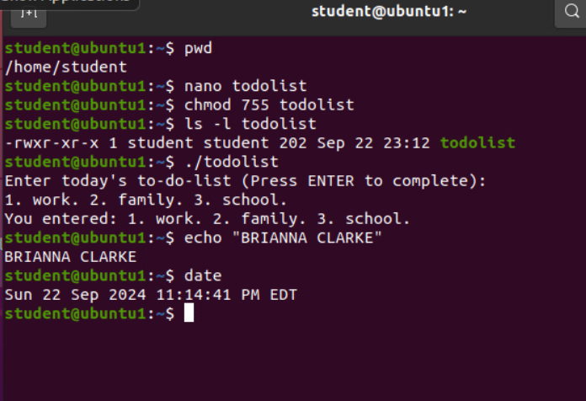
Change script file permissions

Slide 11
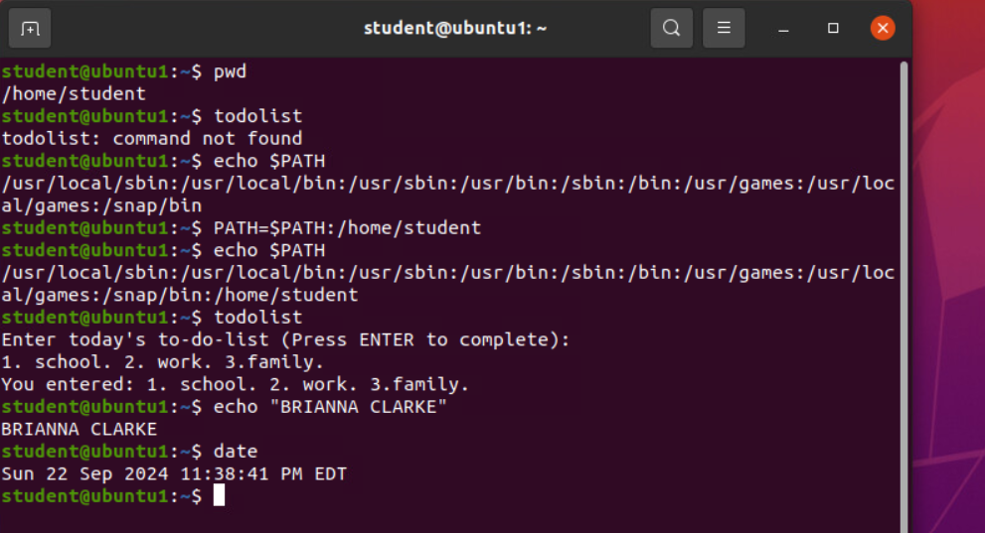
Set the PATH variable

Slide 12
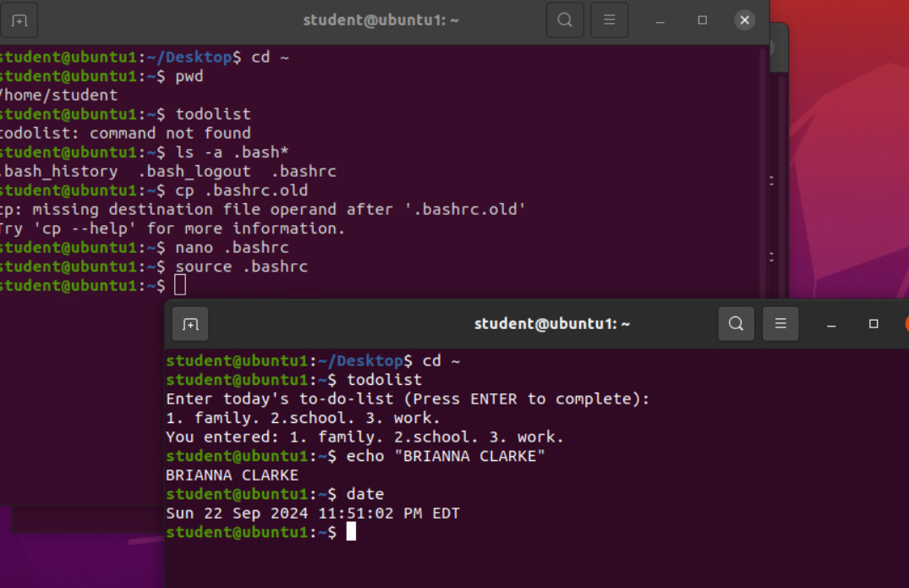
Make the PATH variable permanent

Slide 13
User and group management
Add users and groups in CLI.
Test user and group settings.
Add users in GUI.
Remove users and groups.

Slide 14
Add users and groups in CLI
1. What does the –m option in the useradd command do?
m -- tells useradd command to create a home directory for this new user.
2. What does the -3 option in the tail command do?
-3 -- tells tail command how many lines to chow from the end of the file.
3. Which line of the /etc/group file lists members of the “students” group? Copy it here:

Slide 15
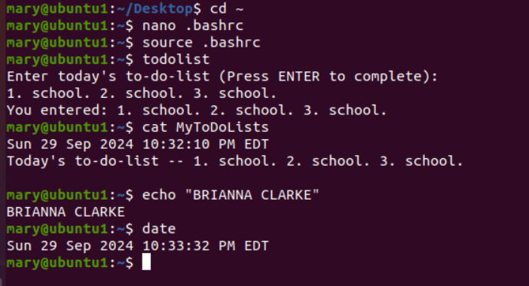
Test user and group settings

Slide 16
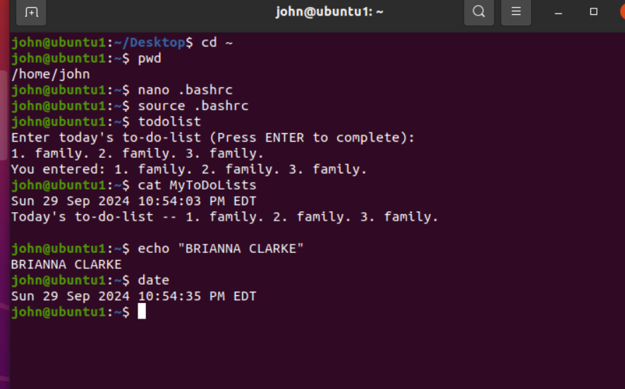
Add users in GUI

Slide 17
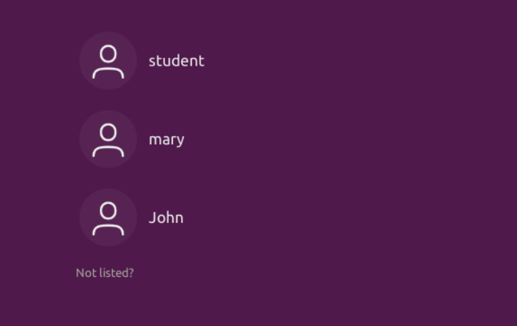
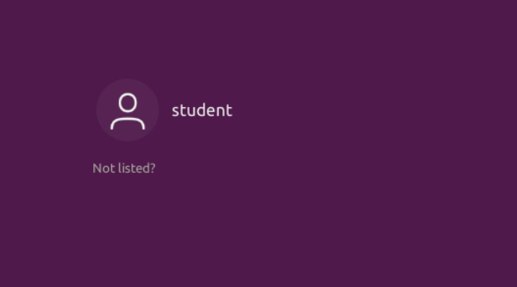
Remove users and groups
Two screenshots are required here.
First, take a screenshot of the log on page with all three accounts from Part 3.
Second, take a screenshot of the log on page with only your user account (i.e., student) from Part 4.

Slide 18
NETWORK CONFIGURATION
Discover host IP configurations.
Manage network interfaces.
User network activities.

Slide 19
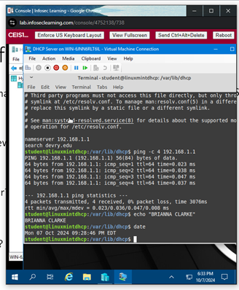
Discover host IP configurations
1. What is the IP address of your Ubuntu machine?
192.168.1.106
2. What is the IP address of its default gateway?
192.168.1.1
3. What is the IP address of its DHCP server?
192.168.1.1
4. What is the IP address of its DNS server?
192.169.1.1

Slide 20
Manage network interfaces
Which DHCP message is shown in the output of the sudo dhclient –v –r eth0 command?
DHCPRELEASE
2. Which four DHCP messages are shown in the output of the sudo dhclient –v eth0 command?
-DHCPDISCOVER
-DHCPOFFER
-DHCPREQUEST
-DHCPACK

Slide 21
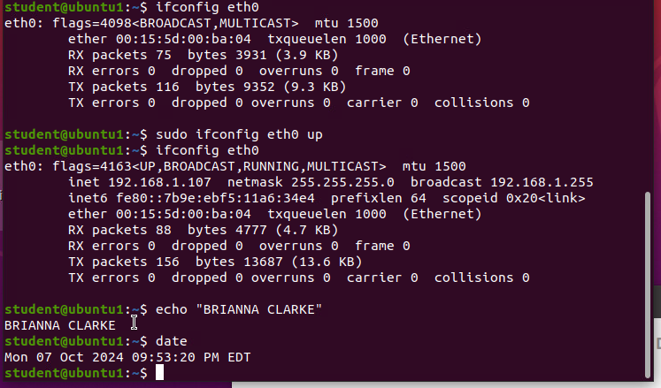
Use network utilities

Slide 22
SYSTEM PERFORMANCE MONITORING
Monitor processes.
Monitor user activities.
Monitor network bandwidth usage.

Slide 23
Monitor Linux processes
1. What is the default action of the 15 SIGTERM kill signal?
Kill the highlighted process.
2. In the System Monitor window, click on % CPU to sort the processes by CPU load. Which process shows the highest percentage of CPU usage?
gnome-shell (GUI)

Slide 24
Monitor user activities
Issue the sudo accton on command to turn on GNC accounting. Run the sudo updatedb command. Enter lastcomm updatedb to check if the updatedb command was executed before. Remember to turn off GNC accounting (sudo accton off) after answering the questions.
1. What flag value is displayed in the output?
S — “super user”
2. Why is the name of the user who ran the processes shown as root, not student?
superuser — since we typed sudo in front of the command.

Slide 25
Monitor network bandwidth usage

Slide 26
Challenges
Linux is case sensitive.
Had challenges using the InfoSec machine.
Terminal commands with their flags, will require more practice.

Slide 27
Career skills
Using this popular corporate operating system provides value.
Using Linux OS makes me more comfortable with Windows and Mac OS.

Slide 28
Conclusion
Linux is used in Cybersecurity, Software Development Networking, and etc.
Linux is fun to use once you become comfortable with it.

