Slide 1
Home Security System Prototype
CEIS101 Final Course Project
July 2024
Brianna CLarke
Prof. Lewis

Slide 2
Introduction
Over the course of CEIS101 our objective was always aimed at our final project which was a home security system with motion sensors and synchronized LED light.
Originally, we learned to create circuits using on Arduino and breadboards on TinkerCad by connecting cathodes and anodes to their corresponding brackets. We learned to clean up our wires as we went along as to not get confused, which came in handy, as our boards began quickly filling up.
The first component of the home security system was adding a sensor to the door, determining whether it was open or closed. The sensor was connected to three different color LED lights and a buzzer for added security. There is a green, yellow, and red light. The green indicating the door is closed and there’s not threat. The yellow and red light, as well as the buzzer, only being set off when the door was open.
We then incorporated a distance sensor to the front door of our smart home security system to monitor for any possible intruder. Based on the distance the ultrasonic sensor detects, a specific light and even buzzer will be activated. The green LED indicating no security risk, yellow indicating possible security threat, and red LED combined with a loud buzzer would indicate high security risk.
Finally, we including a blue smart LED light to the automated home security system. Using out breadboard, we added a photocell and resistor in order to determine the amount of light, based on the voltage readings, at which the blue LED will turn off/on.

Slide 3
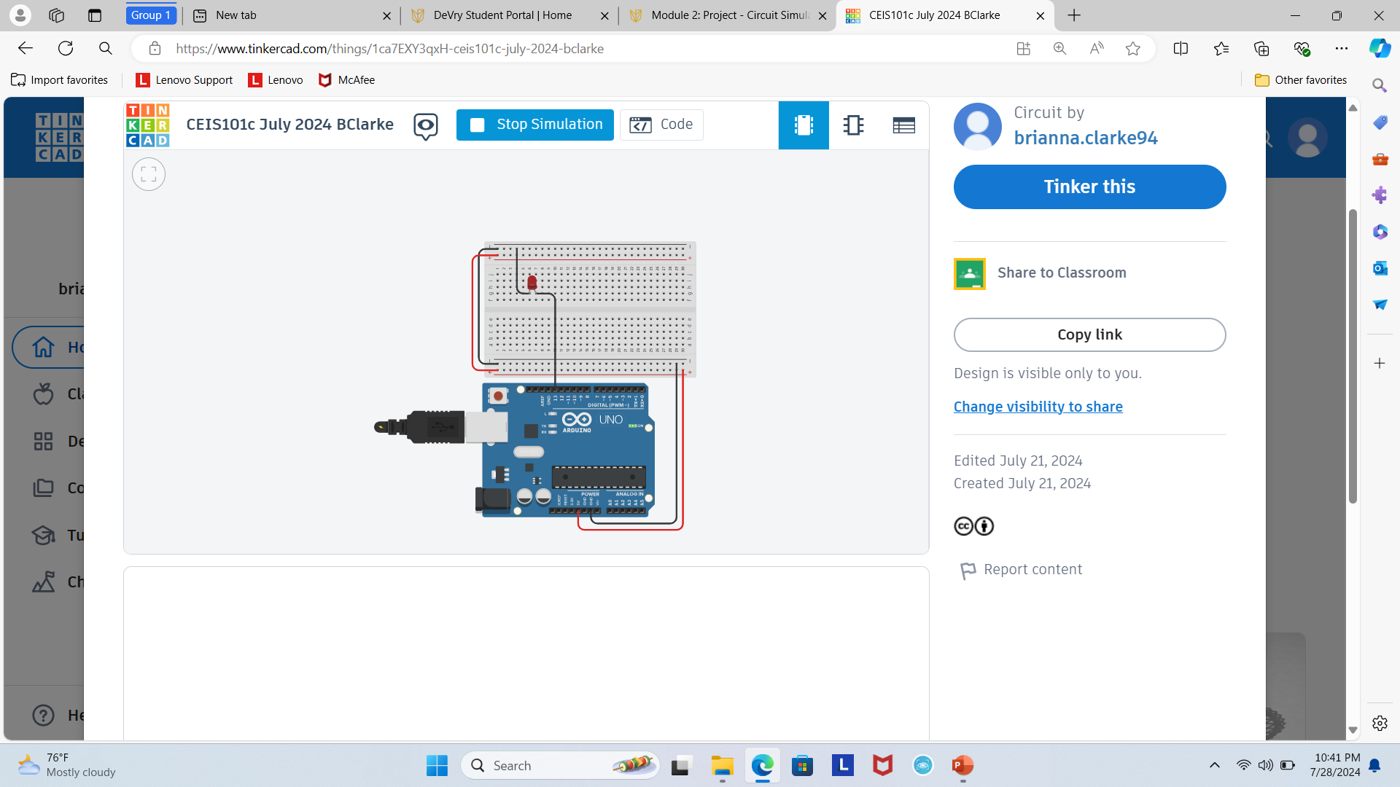
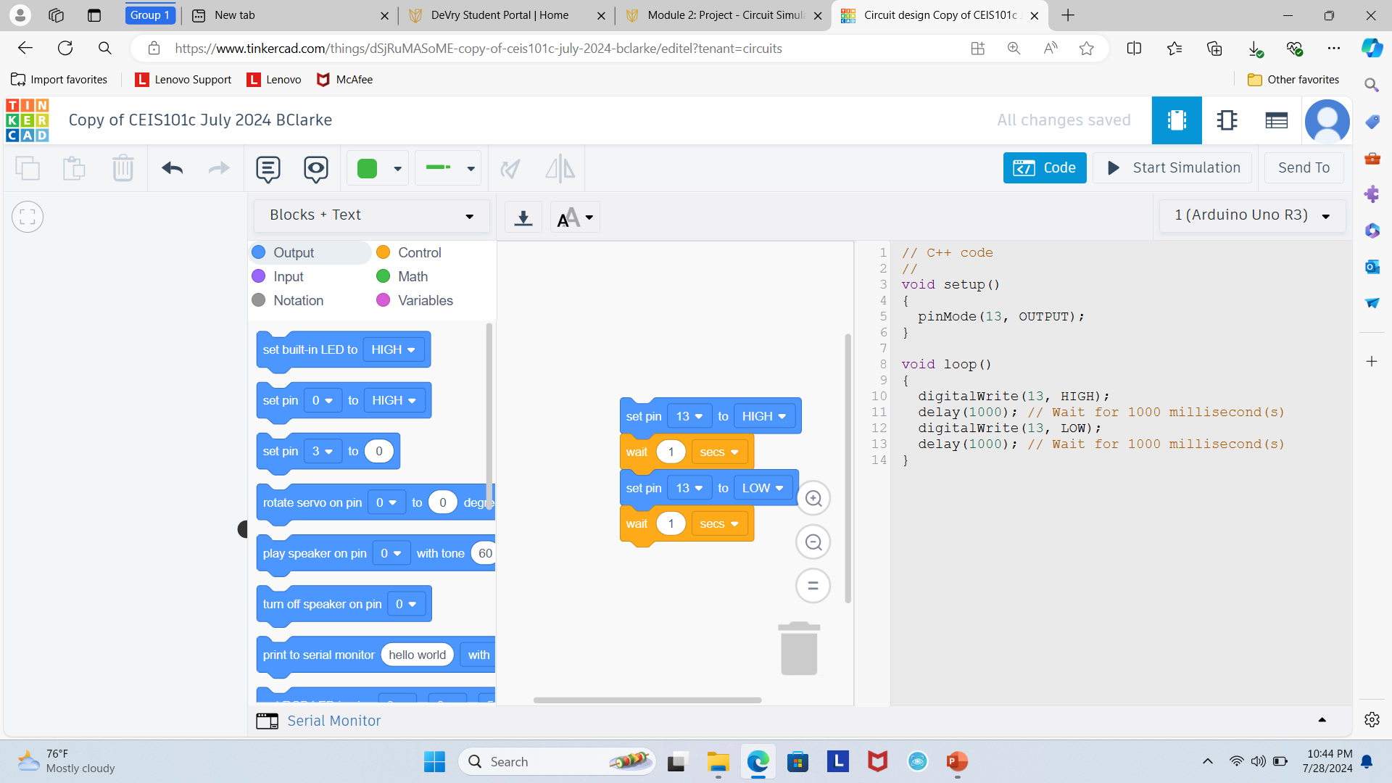
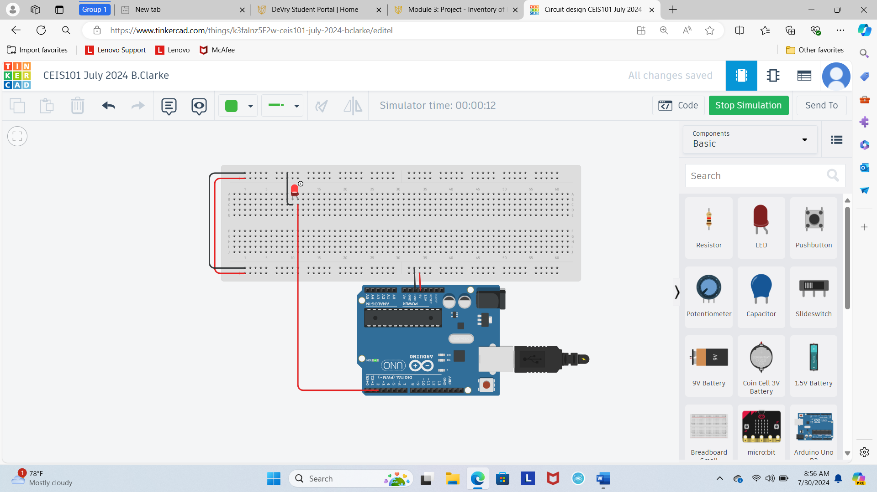
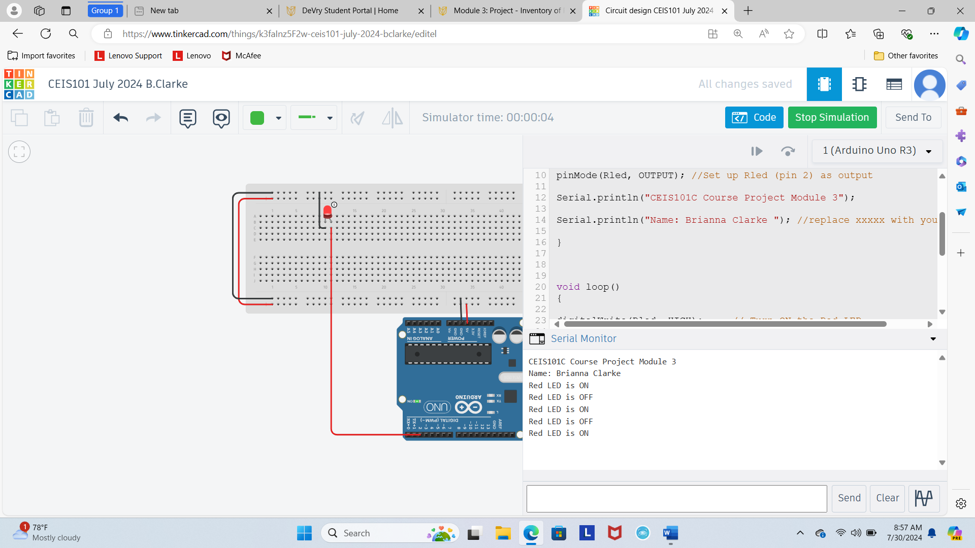
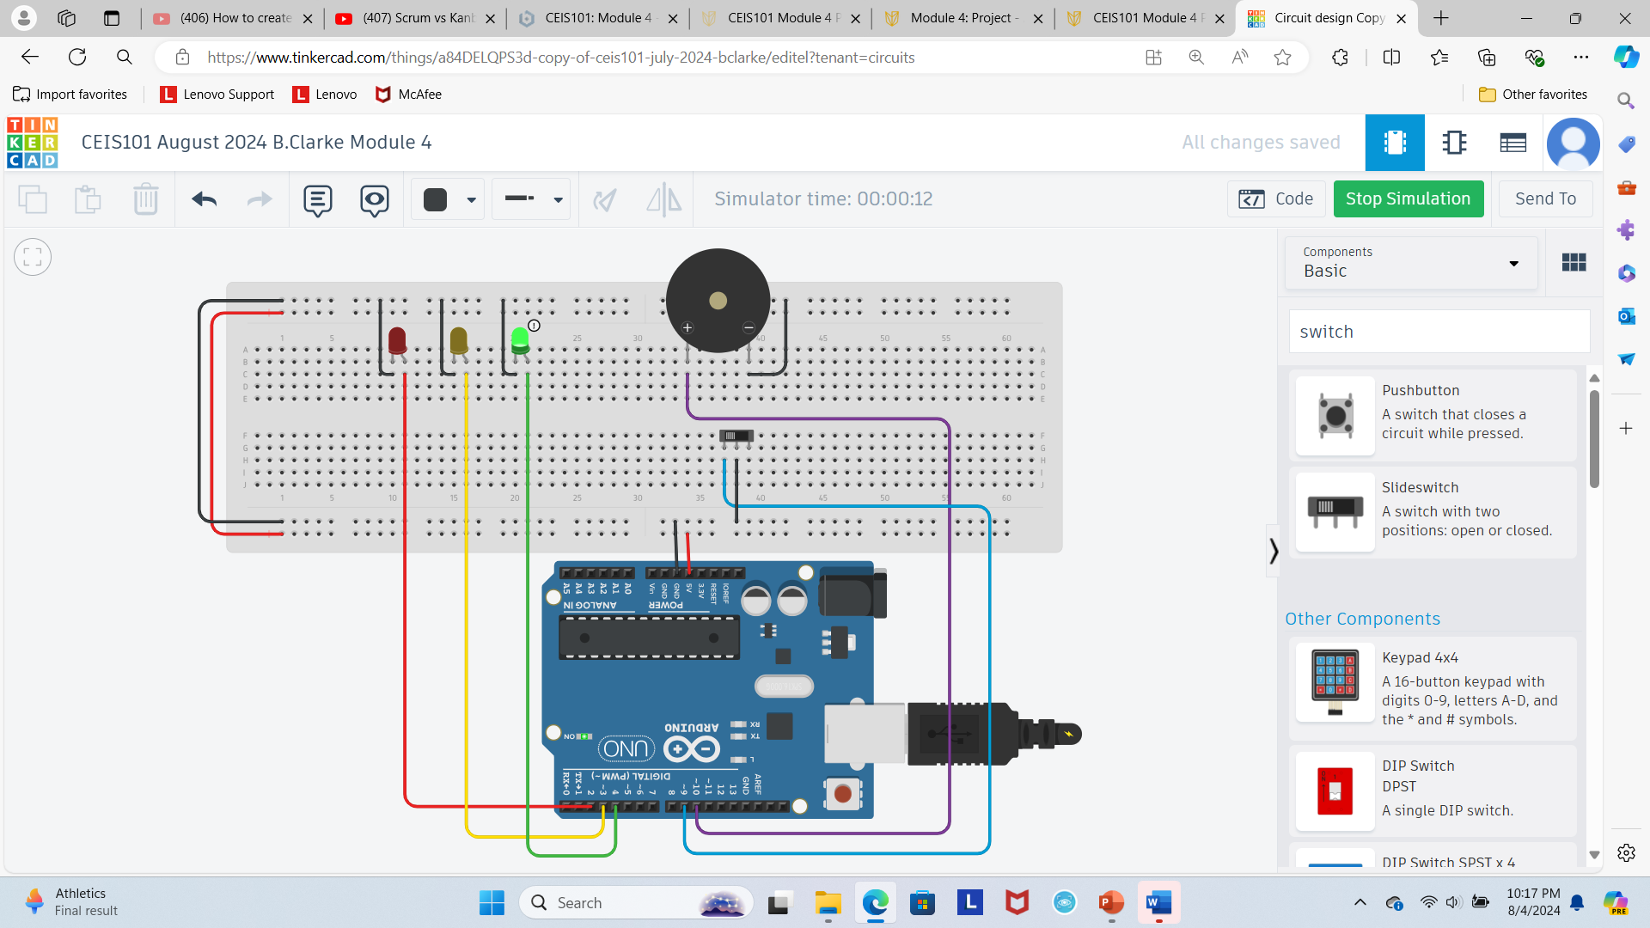
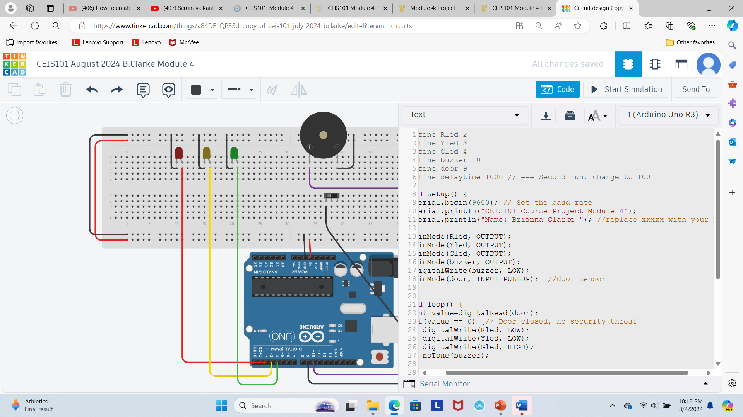
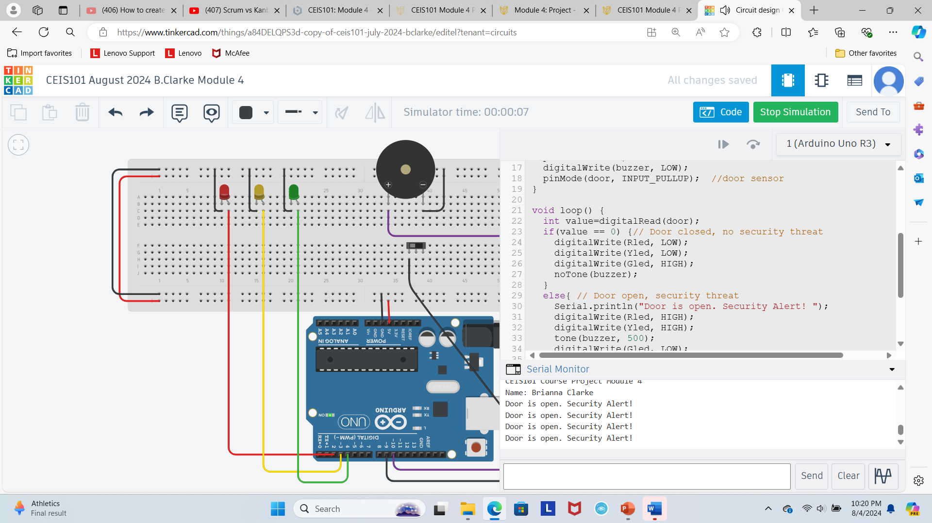
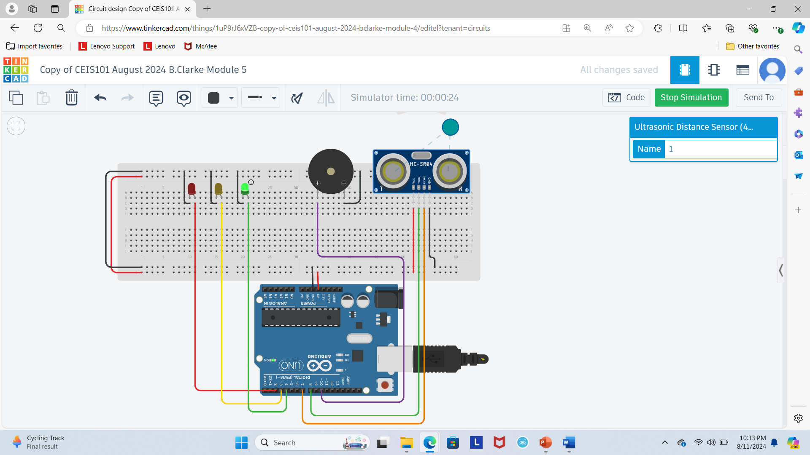
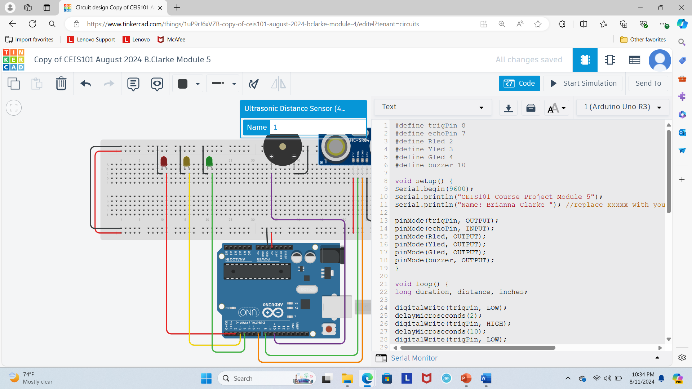
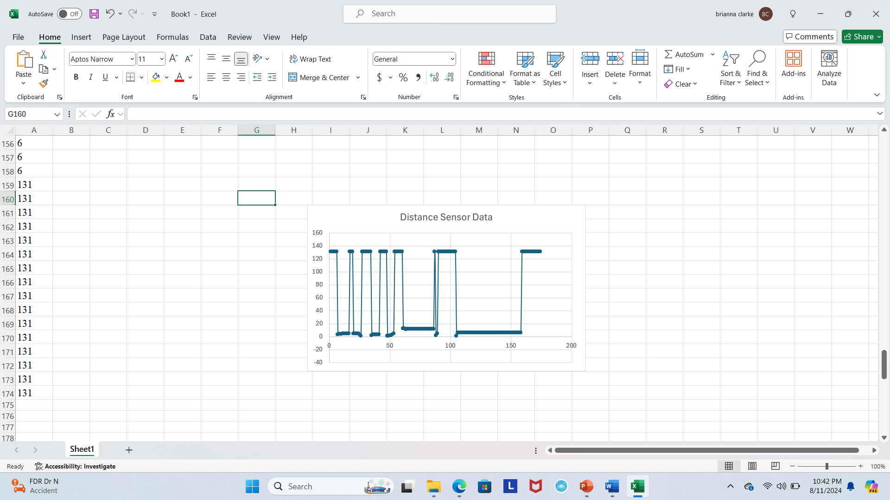
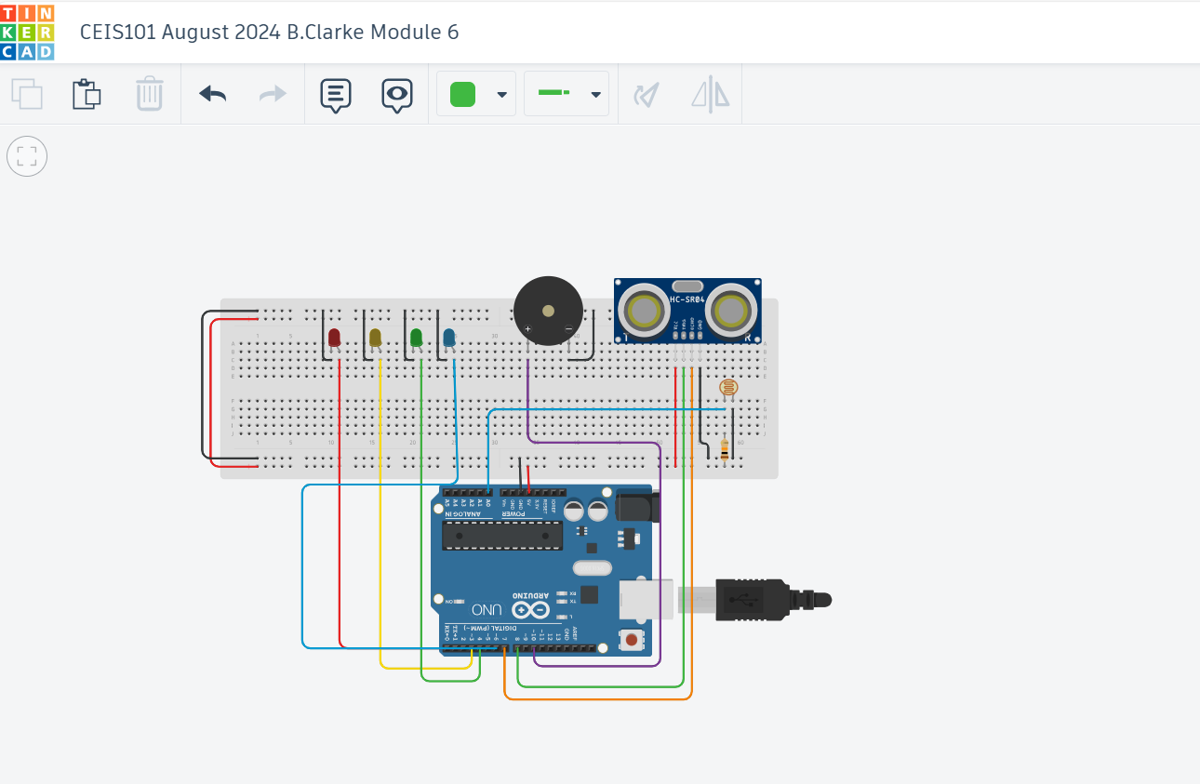
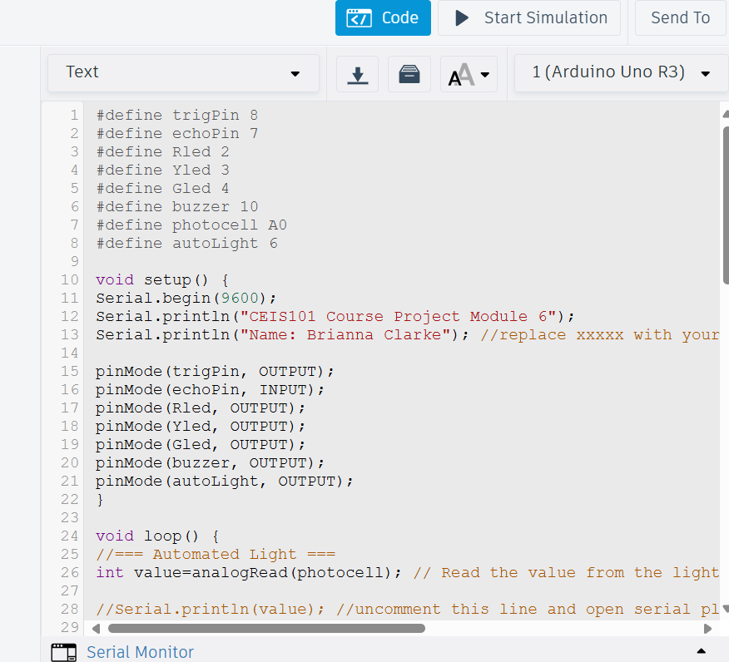
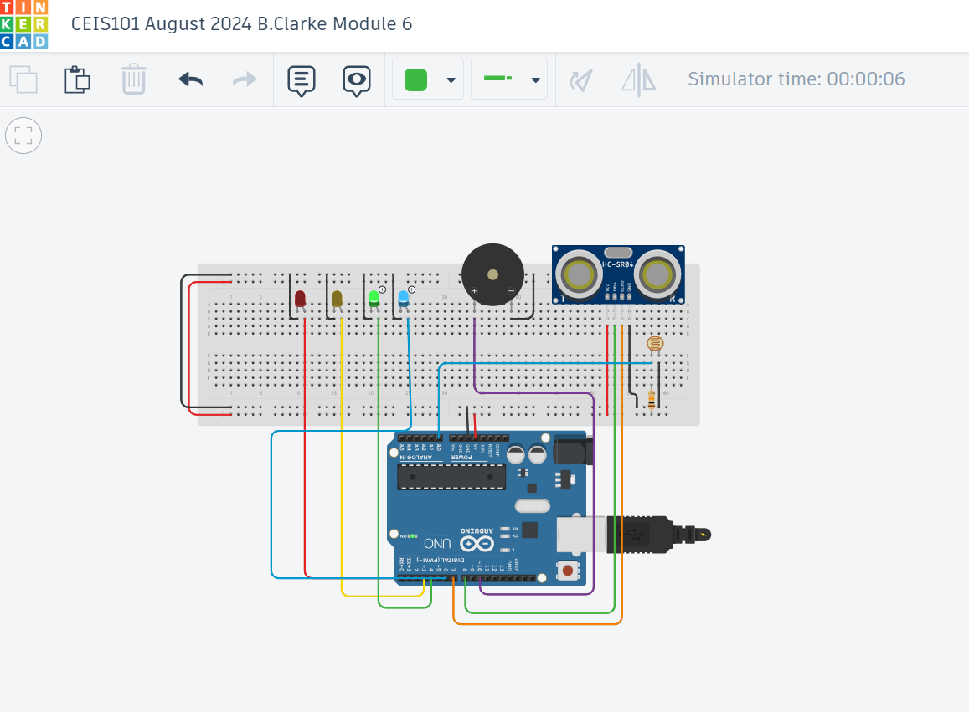
Progression of automated home security system, step by step:

Slide 4
Challenges/Lessons Learned
During working on the home security automation project, the challenges I were mostly out of fear. I had no experience in the field prior and was worried I would be unable to keep up with the course. However, with the help of the Professors and live lessons, I was able to get an understanding for the foundation of operating systems.
Using TinkerCad, I was able to comfortably go about learning Arduino and breadboards as well as creating circuits which can be used for many different purposes. In all, I was able simulate an automated home security system equipped of motion and door sensors, LED lights connected to motion sensor, and additional blue LED light for preference.
Looking back, I learned that there is nothing we can’t accomplish if we put our mind to it. Given the right resources and determination, we can accomplish goals we never thought possible. I learned how to create a circuit, how to present your creation through a power point presentation, including data graphs for how these creations work, how to add LED light and sensor components to a project to maximize customer satisfaction, how to edit code, and even how to make sure your circuit is working properly after being set-up. Overall, I learned that I have so much more to learn in regard to the IoT and I’m excited to take on the challenge.

Slide 5
Career Skills
Throughout CEIS101, I learned a variety of skills and components to the Internet of Things. I learned about the collective intelligence of the internet, some pros and cons of smart cities, how the internet improves environmental monitoring, the Digital Revolution, how not only but also but governments, cities, and organizations alike all benefit from the IoT. The definition of hardware and software, automation and interconnected devices such as robots and robotics, artificial intelligence, smart homes, cars and more. We also reviewed data breach attacks and physical security regarding the importance of cyber security.
Some specific competencies that will help to advance my career that were taught throughout the course include the understanding of the Connection of Things through the IoT. Working knowledge of security circuits, bringing a program to life, proficiency in Microsoft Office products, reliability, and punctuality.
During the preparation and presentation of the final project, several other skills played an ultimate factor, which is why I included all skills needed for a successful completion of the final project. All parts of the project were done in a timely manner, presented on Microsoft Office products, and even included interactive discussions with fellow peers. I believe all these skills are essential to the advancement of my career and I am grateful to have the chance to strengthen them throughout my pursuit, knowing this is just the beginning.

Slide 6
Conclusion
I have to say, I was terrified to begin. But I’m so glad I did. I believe I am now on the right track to learning the ins and outs of the Internet of Things and that gives me confidence in pursuing my goal as a Cyber Security Analyst. I understand how to build circuits and connect them on the same Arduino board and have a working automated system. I now understand P.I.I and how easy it is to potentially be hacked by absolutely and the importance of cyber security, and the demand it holds. And of course, ways to protect our data from potential threats.
Even Big Data has both advantages and disadvantages, how important Operating Systems are (the most important software that runs on a computer or phone and acts as a manager of the hardware) and the variety of them, Software API’s and programming languages were all foreign to me before beginning CEIS101. It seems like in the blink of an eye, I see the World from a digital perspective, and I’m both excited and curious to learn the extent of technology and how far we can go; especially considering the email ever sent was in 1971!

Slide 7
References
Simply my notes taken throughout the course of CEIS101 July 2024, with Professor Lewis.

