Slide 1

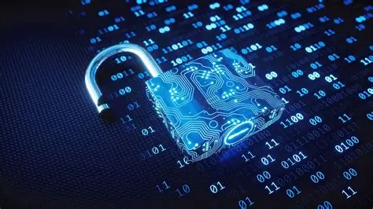
Brianna Clarke
Final Project
SEC285
Fundamentals of Information System Security
Professor J. Mack
DeVry University
Date: 08/22/25

Slide 2
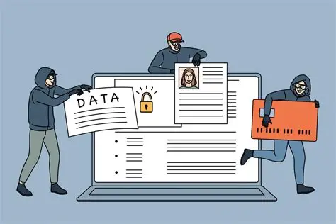
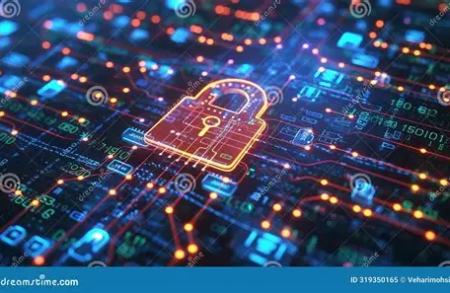
Introduction
This course provided a comprehensive overview of information security fundamentals, covering key concepts such as security threats, defense mechanisms, and risk management strategies. We explored various types of malware, social engineering attacks, and cryptographic techniques, gaining insight into designing effective security solutions. The importance of information security in preventing data theft, identity theft, and cyber terrorism was also emphasized. Throughout the course, we examined security issues related to people, data, networks, and devices, and learned how to apply security principles and best practices. By understanding the fundamentals of information security, we can better protect sensitive information and maintain the confidentiality, integrity, and availability of data. This project showcases my understanding of these key concepts and their practical applications.

Slide 3


2
This module provided a comprehensive overview of cryptography, exploring its role in protecting data through various algorithms and techniques. We examined the fundamentals of cryptography, including its applications and potential vulnerabilities, and built on that foundation to discuss more advanced topics like digital certificates and public key infrastructure. By understanding how cryptography works and its various uses, we can better appreciate its importance in securing online communications and protecting sensitive information.

Slide 4
3
This module focused on network security, covering different types of server attacks and strategies for securing network components. We explored how to integrate security into every aspect of network design and administration. By doing so, we developed a robust security framework to protect against various threats.

Slide 5

4
This project centered on developing a Bring Your Own Device security policy, which highlighted the importance of securing wireless networks and mobile devices. We examined the challenges and benefits of allowing personal devices on organizational networks and developed strategies to mitigate potential risks. By creating a comprehensive BYOD policy, we aimed to balance employee flexibility with robust security measures.

Slide 6


567
This project focused on multifactor authentication and access management, covering principles and best practices for controlling user access and securing user accounts. We explored identity and access services, and learned how to implement effective access control measures. By enforcing strong authentication, we can protect sensitive information and prevent unauthorized access.

Slide 7

567
In this project, we conducted a vulnerability assessment that built on what we learned about data security and risk mitigation. We used vulnerability data to understand potential risks in business environments and developed strategies to address them, ensuring organizations can prepare for and respond to disruptions effectively.

Slide 8
Challenges
Throughout the course, I faced challenges in understanding complex security concepts and protocols, requiring dedication and persistence to master. Balancing coursework with other responsibilities also demanded strong time management skills. Additionally, staying up-to-date with the latest security threats and technologies proved to be a challenge, but one that ultimately enhanced my knowledge and skills in information security. Furthermore, I had to overcome unexpected technical difficulties with my laptop and subsequent replacement system, which added an extra layer of complexity to completing the project on time.

Slide 9

Career Skills
Through this course, I've developed key skills that will serve me well in the field of information security. I've gained a solid understanding of security principles and best practices, including threat analysis and risk management. I'm equipped to identify and mitigate various types of malware and social engineering attacks. I've also learned to apply cryptographic techniques and security protocols to protect sensitive information. Additionally, I've developed skills in designing security solutions and policies that ensure the confidentiality, integrity, and availability of data. These skills will enable me to contribute to the development of secure systems and networks.

Slide 10

Conclusion
This experience has not only deepened my understanding of information security concepts but also given me a greater appreciation for the importance of protecting our digital lives. I've gained a new perspective on the vulnerabilities that exist in our increasingly connected world and the need for robust security measures to safeguard our personal and professional systems. I'm grateful for the opportunity to continue on this journey and contribute to the field of information security, which is constantly evolving and impacting our communities in profound ways.

Slide 11

Wix link
https://www.briannaclarke.com/tech-core-projects

Slide 12
Refrences
Devry Univeristy, 2017. CompTIA Security+ Guide to Network Security Fundamentals (Book).
All images retrieved from Google Images, various sources, no copyright claimed. Used for educational purposes only.

